Slide 1
CS 5283 Computer Networks
Finding the shortest path with SDN RYU
Manda Li
Tianfang Liu
Xihan Fu
(in alphabetical order)

Slide 2
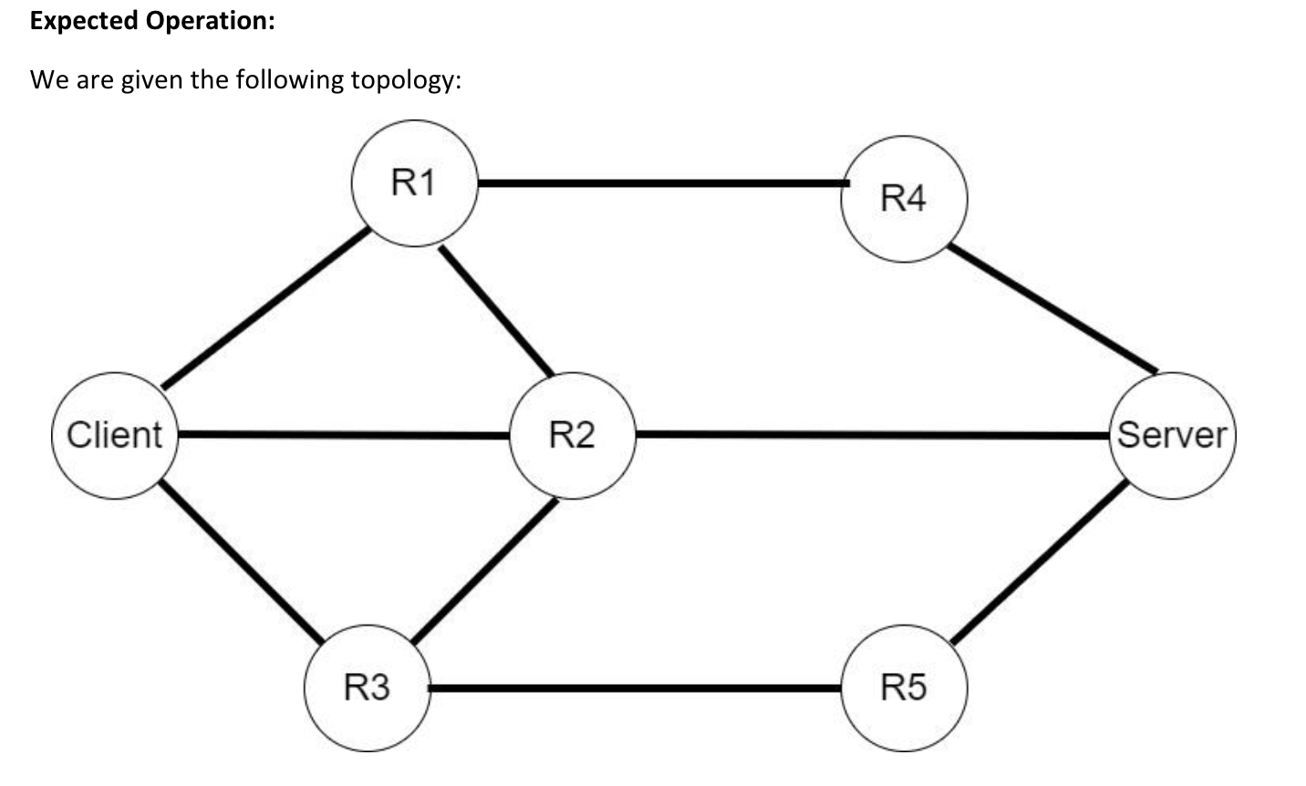
Overview
R7
R6

Slide 3
Overview
R7
R6

Slide 4
Overview
R7
ARP Storm
R6

Slide 5
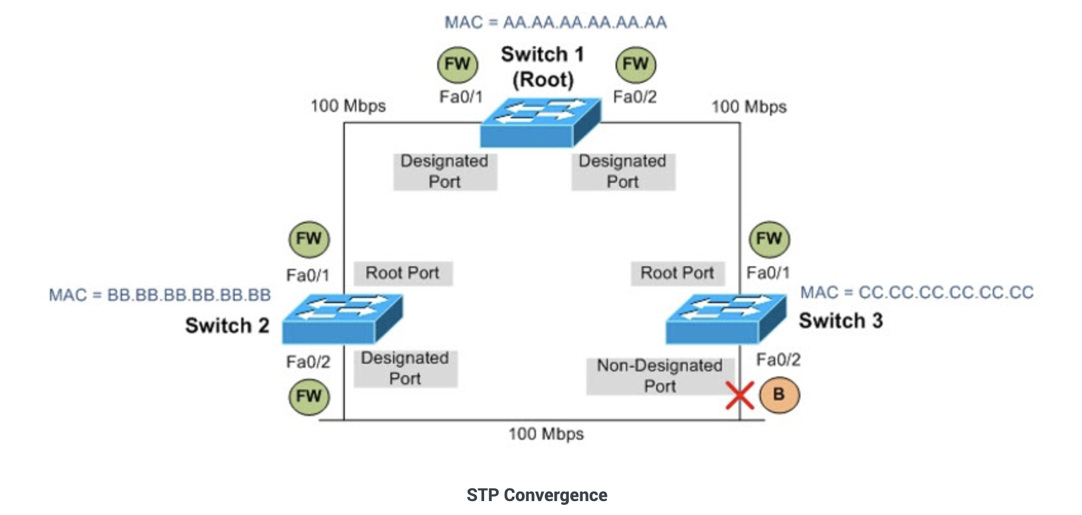
Solution1. STP Protocol
STP：The Spanning Tree Protocol (STP),is a loop-prevention protocol that allows switches to communicate with each other in order to discover physical loops in a network. If a loop is found, the STP specifies an algorithm that switches can use to create a loop-free logical topology. This algorithm creates a tree structure of loop-free leaves and branches that spans across the Layer 2 topology.
Loops occur most often as a result of multiple connections between switches, which provides redundancy, as shown below in the figure.

Slide 6
Solution2. Controller
Use (dpid, mac, dstination ip) as the key value to record the corresponding port. Each switch will record it when it receives the broadcast Arp Request for the first time. The next time it receives the Arp Request with the same key value but different port, it will directly discard the packet. Thereby, it could avoid flooding .

Slide 7
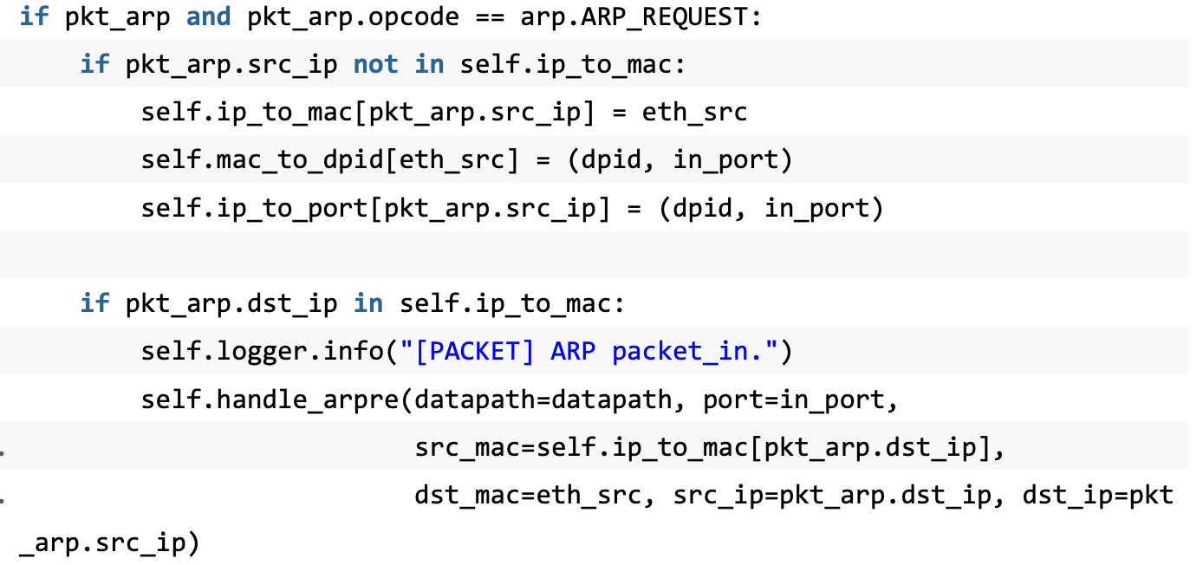
Solution2. Controller
Initialize ip_to_mac, mac_to_dpid which are used to store data. ip_to_mac is used to store the mac address corresponding to each ip, and mac_to_dpid uses the mac address of each host as the key value to store the the dpid of the switch which is connected to the switch port, and the port of the host, the value is (dpid,port).

Slide 8
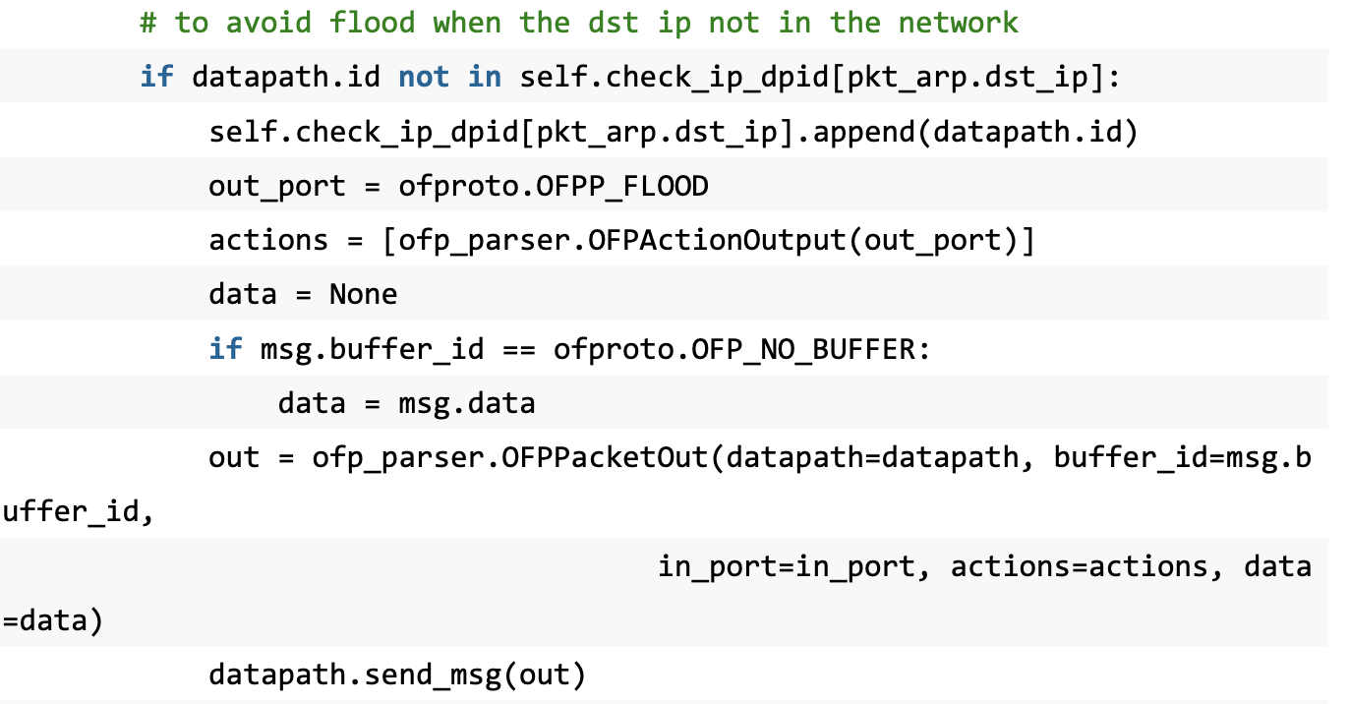
Solution2. Controller
If it does not exist, we can only choose to flood the ARP. At the same time, in order to deal with ARP flooding when the destination address is not in the network, we should create a check_ip_dpid dictionary, with ip as the key and a list of dpids as the value. Whenever the switch must flood send an ARP packet, use the requested ip as the key to find out whether the current dpid exists in the dictionary. If it exists, it means that the switch has forwarded the ARP requesting the ip before, and it will not be processed this time. If If it does not exist, it will be flooded and forwarded after being recorded in the dictionary.

Slide 9
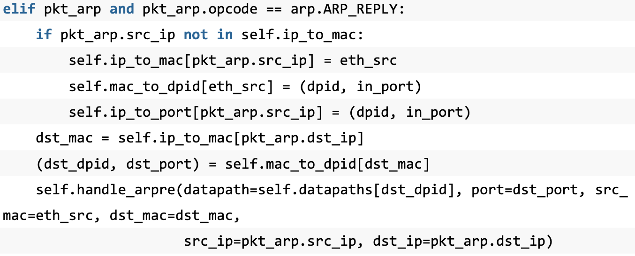
Solution2. Controller
When the switch receives the ARP reply message, we also check the ip that sent the reply message and record the relevant data. At the same time, directly search for data from ip_to_mac and mac_to_dpid, and direct the switch from the controller to the destination host of the reply message to send a reply message directly to the destination host, eliminating the intermediate reply message transmission process

Slide 10
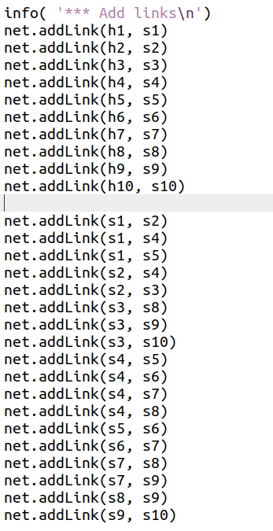
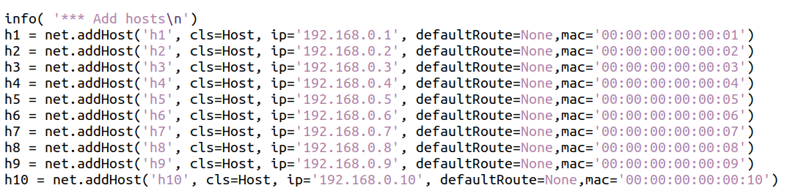
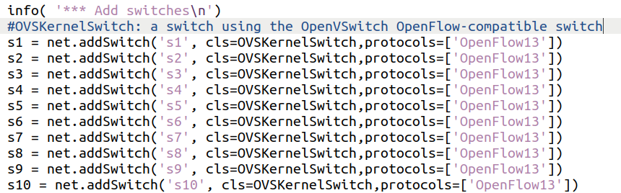
Creating the Topology

Slide 11
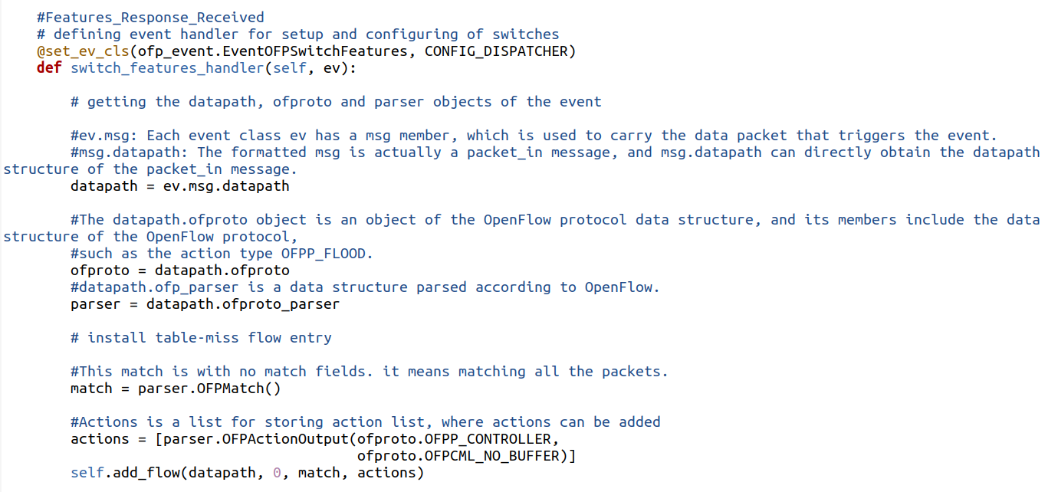
defining event handler for setup and configuring of switches

Slide 12
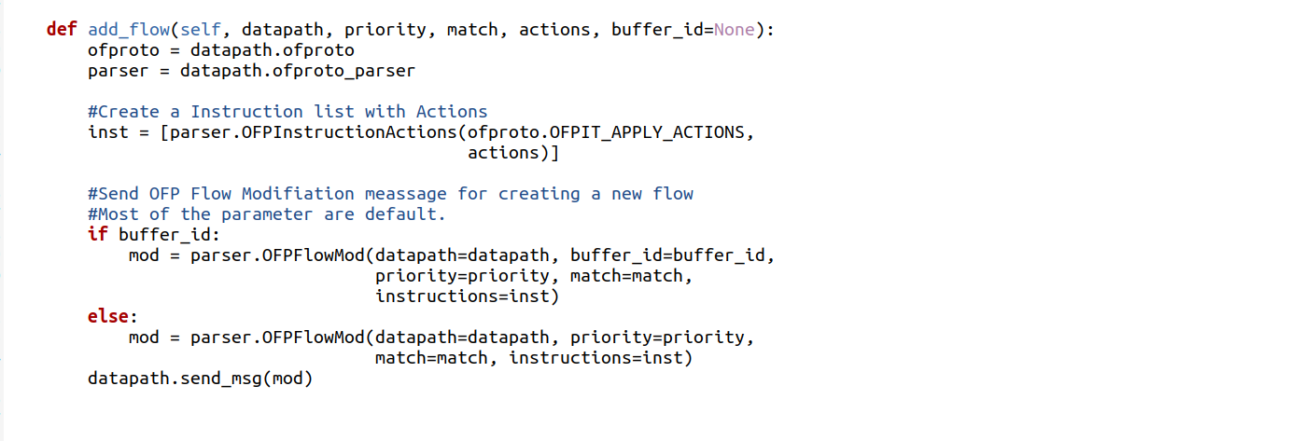

Slide 13
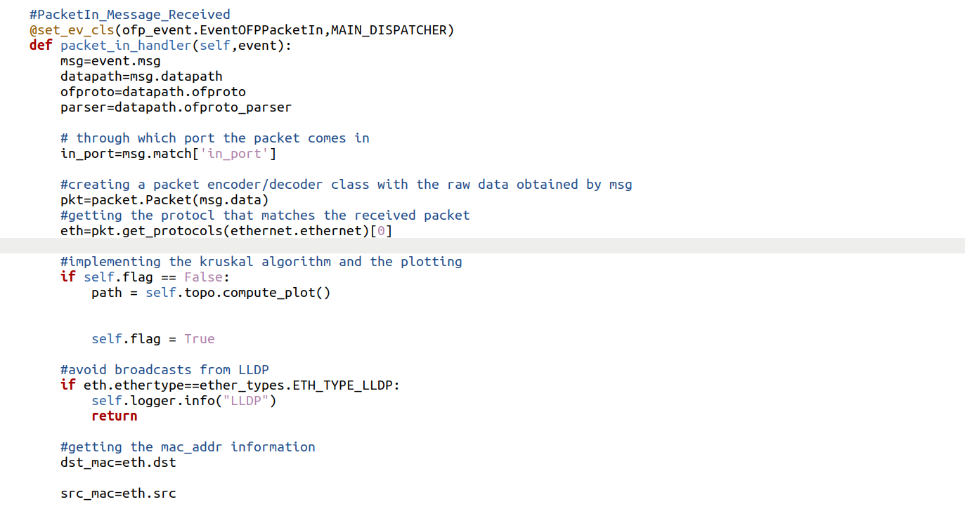
Handling incoming packets

Slide 14
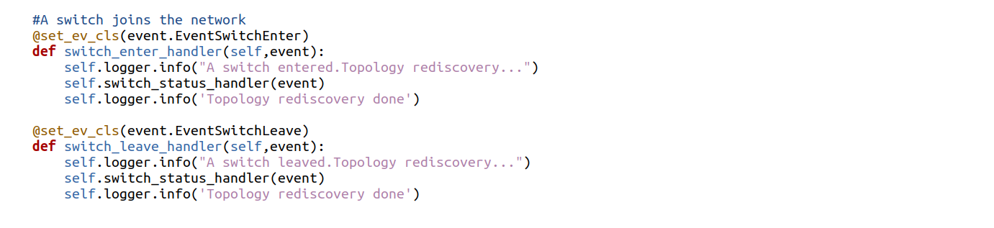
If a switch joins or leaves the network

Slide 15
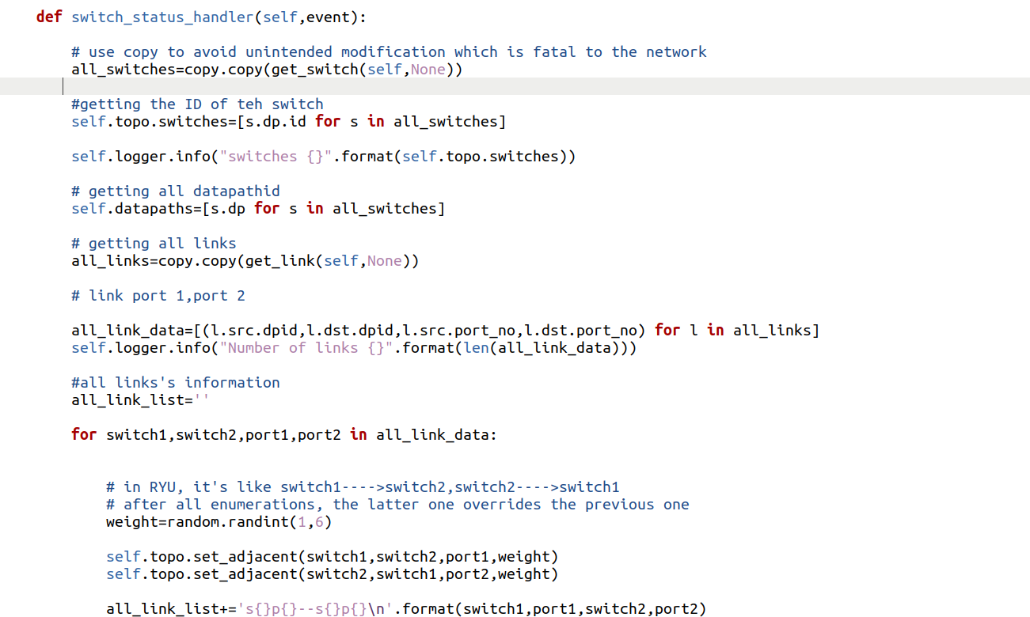
Obtaining topology information from switches and links and using it as the basis for Kruskal algorithm

Slide 16
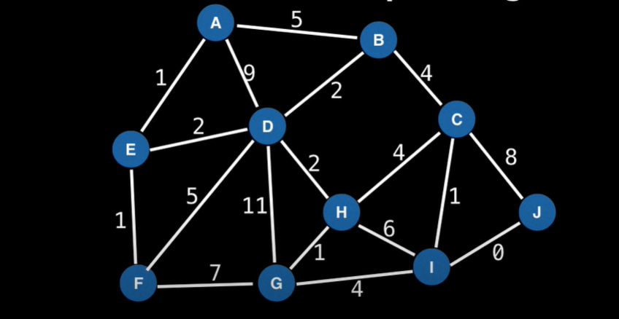
Kruskal Alogorithm
Given a graph G = (V.E) we want to find a Minimum Spanning Tree in the graph (it may not be unique). A minimum spanning tree is a subset of the edges which connect all vertices in the graph with the minimal total edge cost.

Slide 17
Kruskal Alogorithm
Sort edges by ascending edge weight.
Walk through the sorted edges and look at the two nodes the edge belongs to, if the nodes are already unified we don't include this edge, otherwise we include it and unify the nodes.
The algorithm terminates when every edge has been processed or all the vertices have been unified.

Slide 18
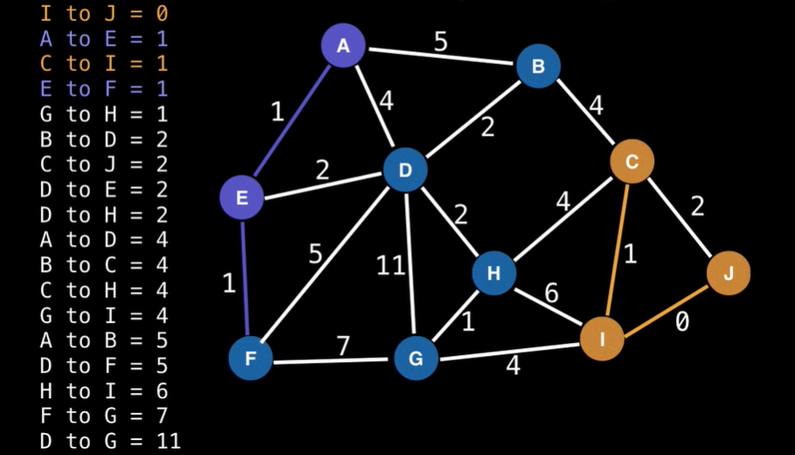
Kruskal Alogorithm
Sort edges by ascending edge weight.
Walk through the sorted edges and look at the two nodes the edge belongs to, if the nodes are already unified we don't include this edge, otherwise we include it and unify the nodes.
The algorithm terminates when every edge has been processed or all the vertices have been unified.

Slide 19
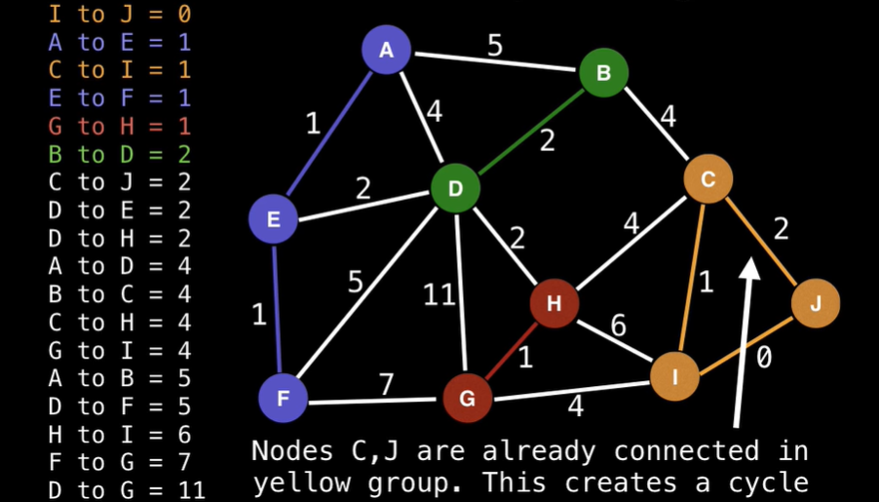
Kruskal Alogorithm
Sort edges by ascending edge weight.
Walk through the sorted edges and look at the two nodes the edge belongs to, if the nodes are already unified we don't include this edge, otherwise we include it and unify the nodes.
The algorithm terminates when every edge has been processed or all the vertices have been unified.

Slide 20
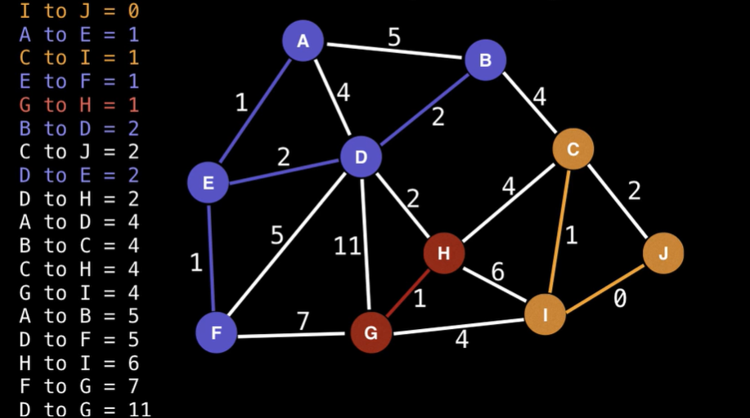
Kruskal Alogorithm
Sort edges by ascending edge weight.
Walk through the sorted edges and look at the two nodes the edge belongs to, if the nodes are already unified we don't include this edge, otherwise we include it and unify the nodes.
The algorithm terminates when every edge has been processed or all the vertices have been unified.

Slide 21
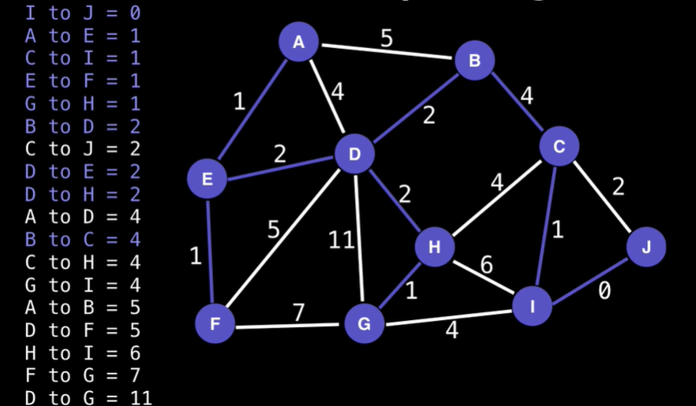
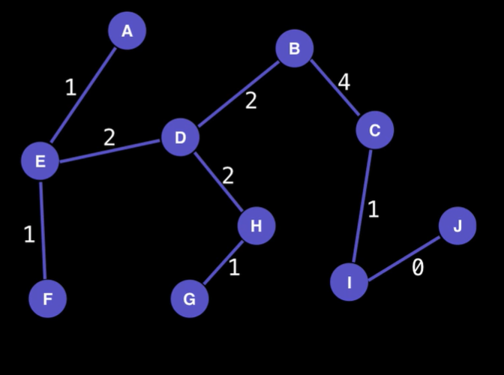
Kruskal Alogorithm

Slide 22
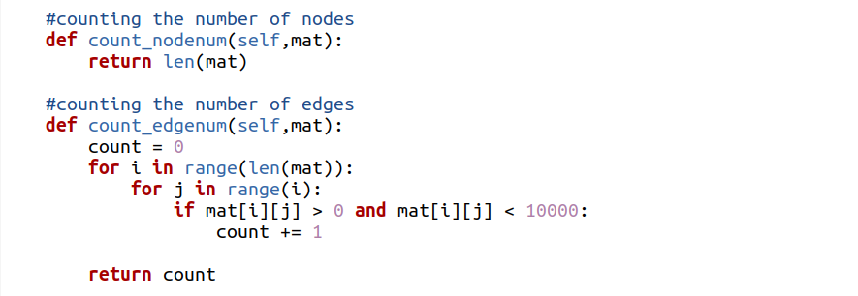
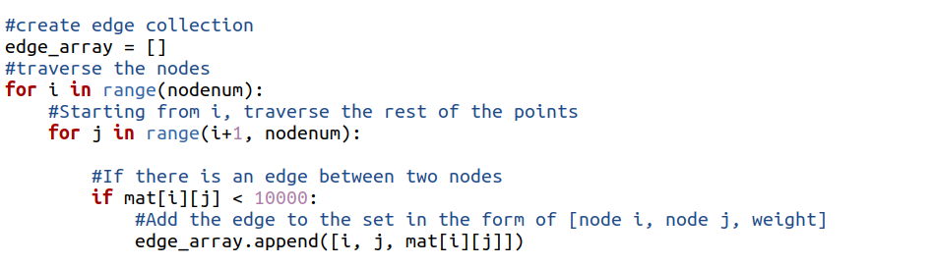
Kruskal Alogorithm
Counting the number of nodes
Counting the number of edges
initializing

Slide 23
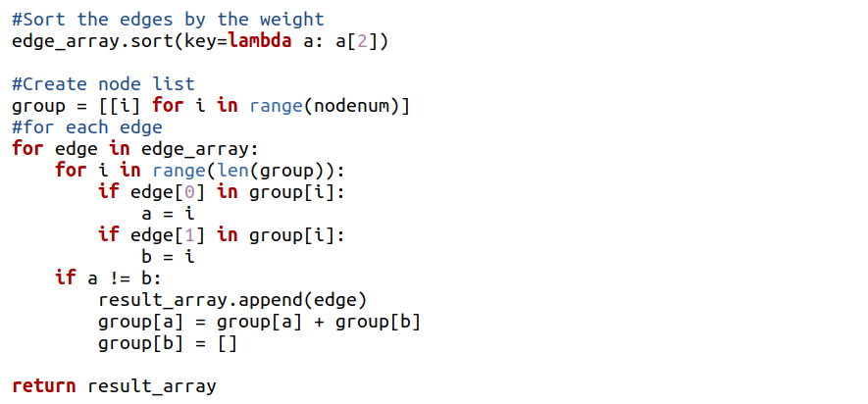
Kruskal Alogorithm
Sort edges by ascending edge weight.
Walk through the sorted edges and look at the two nodes the edge belongs to, if the nodes are already unified we don't include this edge, otherwise we include it and unify the nodes.
The algorithm terminates when every edge has been processed or all the vertices have been unified.

Slide 24
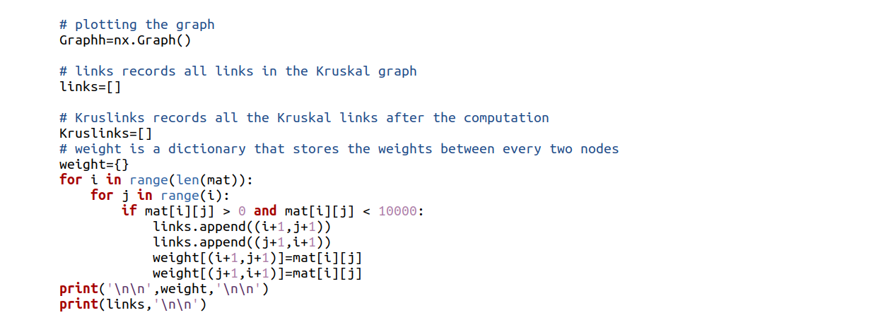
Plotting the graph with module Networkx

Slide 25
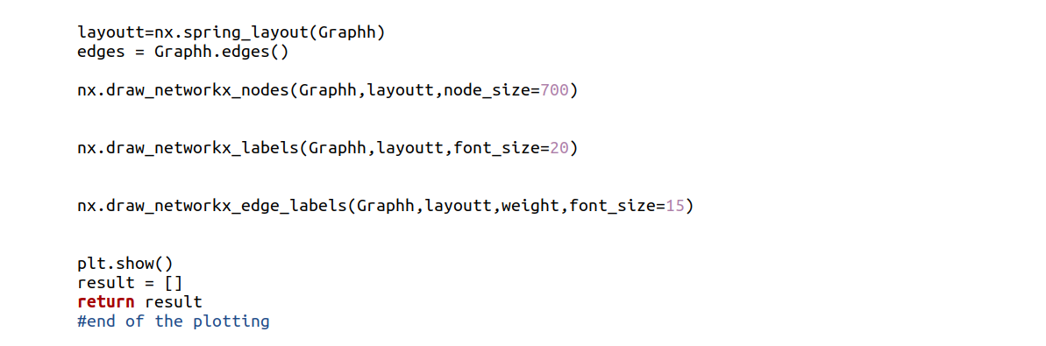
Plotting the graph with module Networkx

